Slide 1
Capstone Founders’ Bakery

Slide 2
Introduction : Business Problem
A group of undergraduate students from the University of Toronto (UofT) are looking to open a new bakery. In order to do so, they will need to gather capital by getting their fellow students to invest in their new venture via the Kickstarter portal.
This project aims to determine the optimal location of the new proposed bakery in order to get buy-in from their peers.
The founders would prefer a neigborhood is physically close to the UofT campus and does not have a bakery in the neighborhood. Ideally, the location should also be similar to the UofT neighborhood as the founders are targetting a similar demographic population.

Slide 3
Description of Data
Following data sources will used for this data analysis:
Beautiful Soup was used to scrape the following Wikipedia page, https://en.wikipedia.org/wiki/List_of_postal_codes_of_Canada:_M
The coordinates of the University of Toronto campus and neighborhoods in the Downtown Toronto borough were obtained using **Google Maps API geocoding**
The number of bakery and their location in every Downtown neighborhood were obtained using Foursquare API
The types of venues in each Downtown Toronto neighborhood were obtained using Foursquare API

Slide 4
Methodology
1. Identify the location of the UofT campus and the which borough it is located in
2. Identify the neighborhoods that are in the borough UofT is located in
3. Explore location of bakeries within each neighborhood
4. Determine which neighborhood does not have a bakery
5. Analysis the similarity of each neighborhood by clusters using k-means clustering

Slide 5
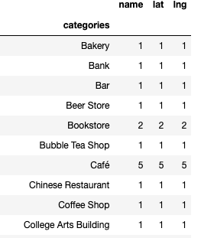
Analysis – Exploring UofT campus
The venues available within the University of Toronto campus were identified. As there is one bakery in the area, it would not be ideal to set up a new bakery in this neighborhood in order to avoid competition

Slide 6
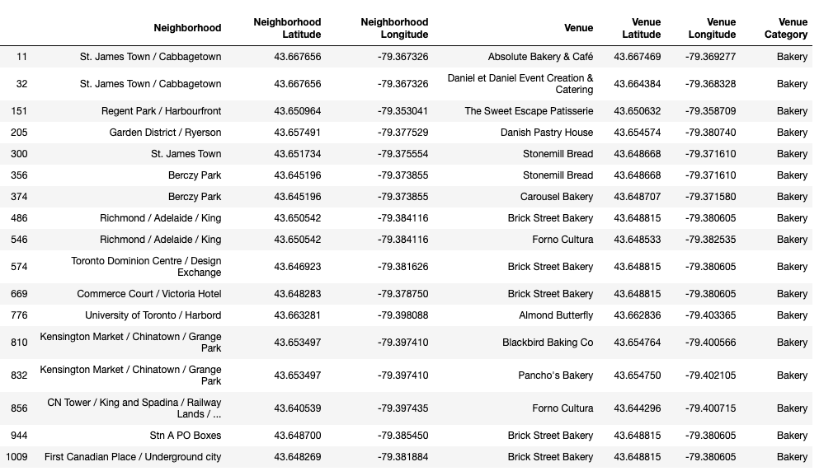
Analysis – Identifying bakeries in the neighborhoods nearby

Slide 7
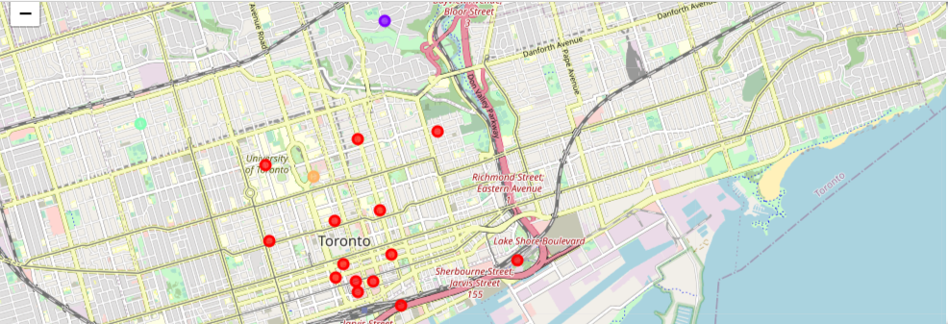
Analysis – Downtown Toronto neighborhood clusters based on their similarities

Slide 8
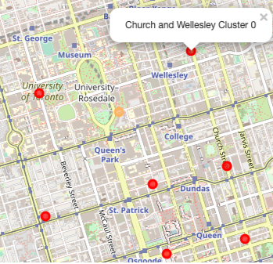
Result
* Since there is a bakery within the UofT neighborhood, it will not be ideal to set up a new bakery within the vicinity in order to avoid competition
* As UofT is located within the Downtown Toronto borough, different neighborhood within this borough were considered to be potential candidates for the location of the new bakery
* The closest neighborhoods to the UofT campus that do not have bakeries were identified to be Queen's Park, Church and Wellesley, and Central Bay
* After examining these three neighborhoods, Church and Wellesly was found to be the most suitable location because it was similar to the UofT neighborhood (based on cluster analysis) and was closer to the UofT neighborhood when compared to the Central Bay neighborhood

Slide 9
Conclusion
* The purpose of this project was to identify a potential location for a new bakery based on the founders' criteria.
* Narrowing the choice of location to Church and Wellesley is the first step to for the bakery's founders as they will need to perform further investigation and market research on this neighborhood to assess its potential for their new venture

